Slide 1

IMDb Database
By: Bradley Turnage, Aiden Cary, Moulc Doumbia
04/15/2025
CUB CODRS

Slide 2
Introduction
Relational Schema Diagram
The Loaded Data
Three Interesting Queries + Screenshots
Problems!

Slide 3
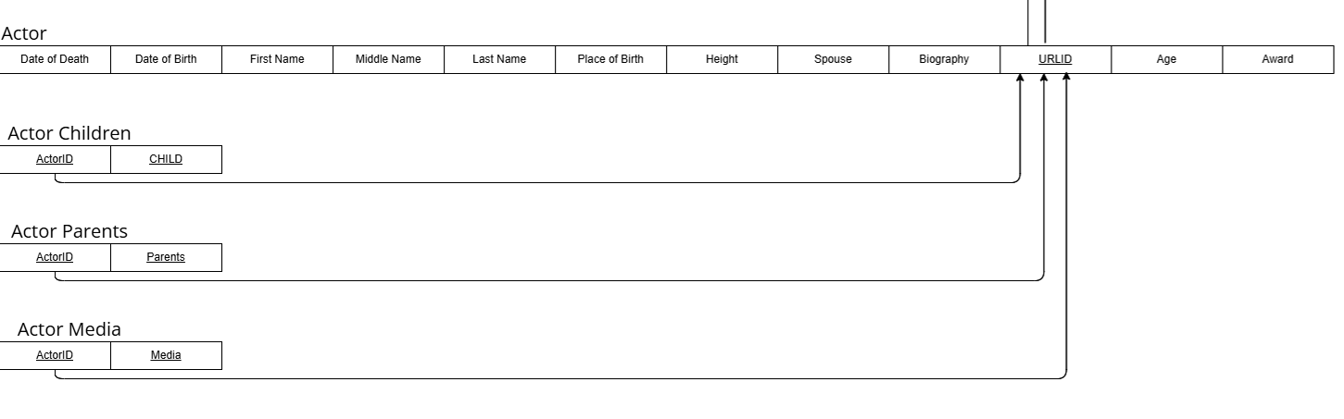
Actor Table & Multi-Value Tables

Slide 4
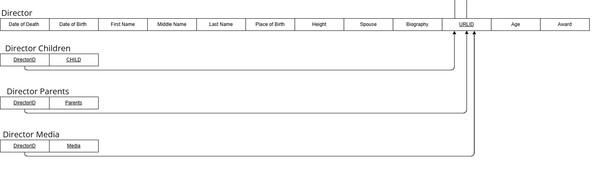
Director Table & Multi-Value Tables

Slide 5
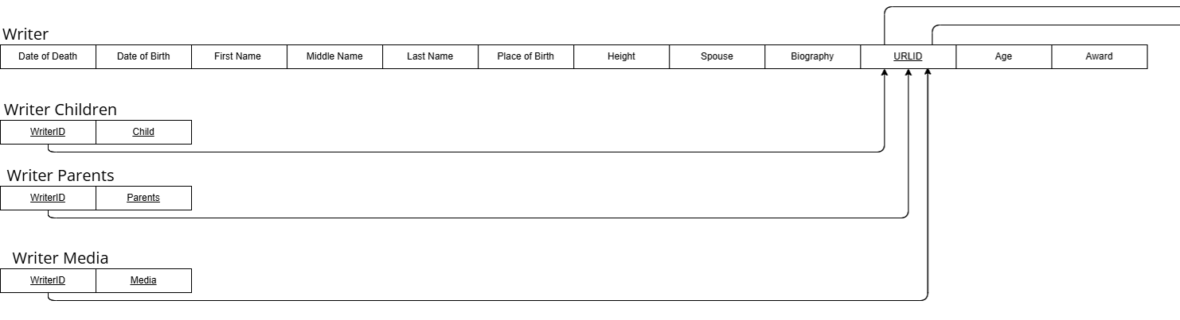
Writer Table & Multi-Value Tables

Slide 6
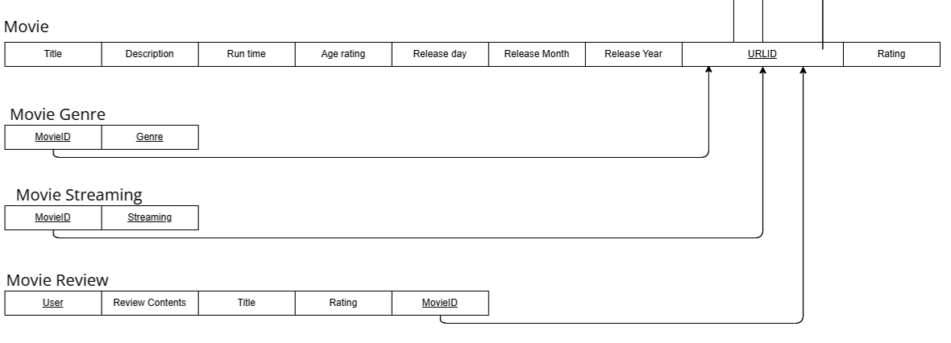
Movie Table & Multi-Value Attributes

Slide 7
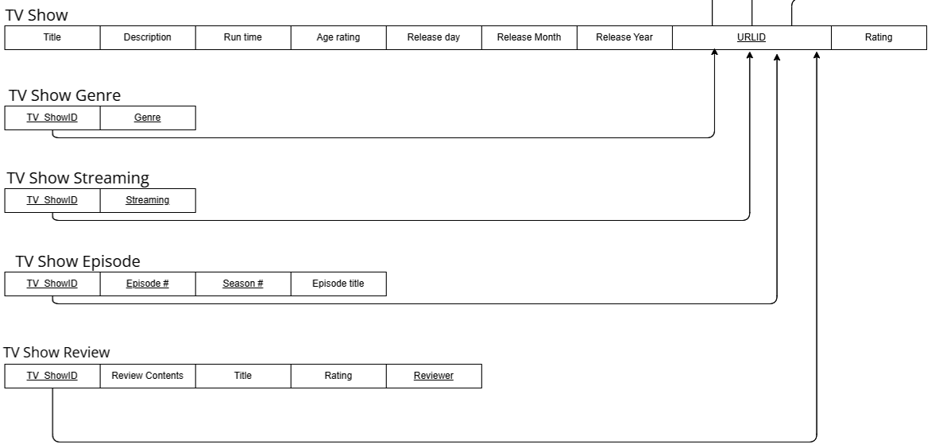
TV Show Table & Multi-Value Attributes

Slide 8
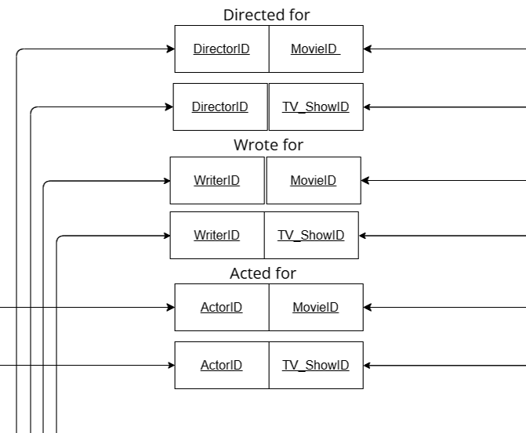
Junction Table/Relationship Tables

Slide 9


Slide 10

Highlighted Inserted Data
Actor
Movie
TV Show
Writer
Director
SO MANY INSERTS!!!!

Slide 11
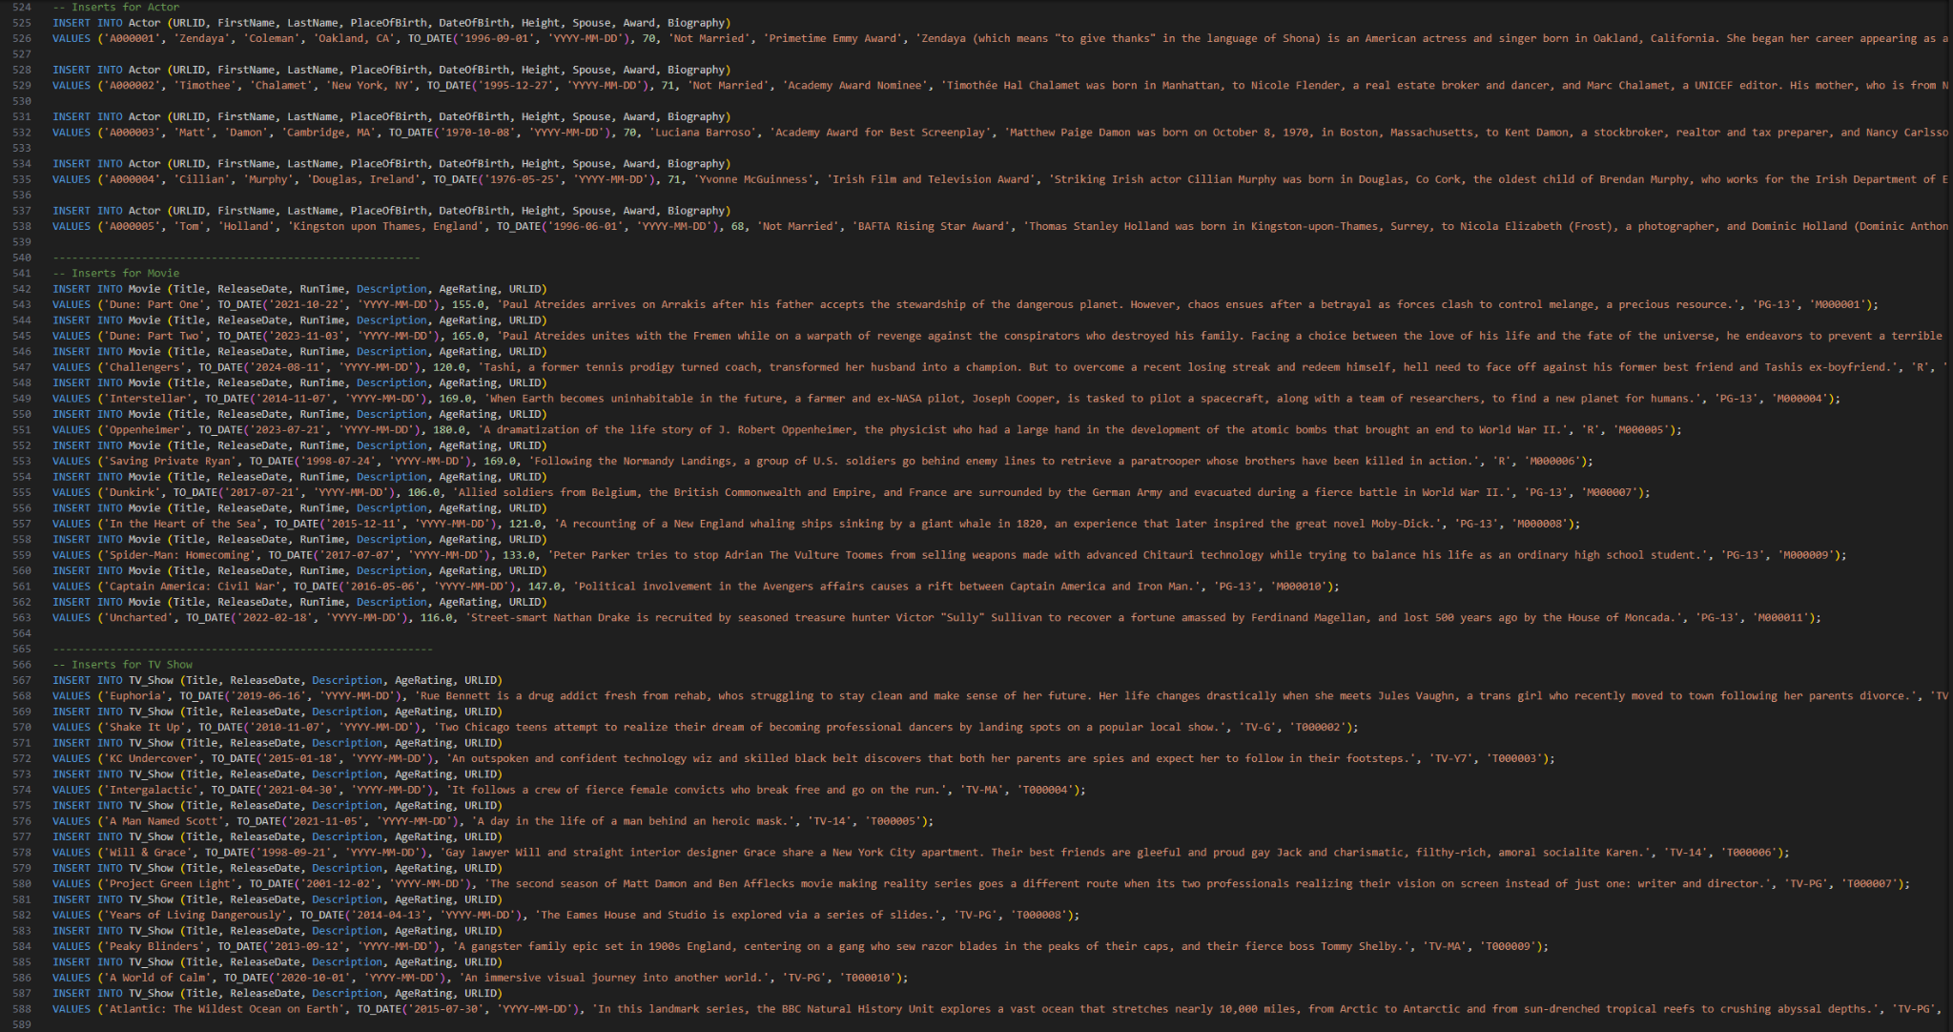

Slide 12
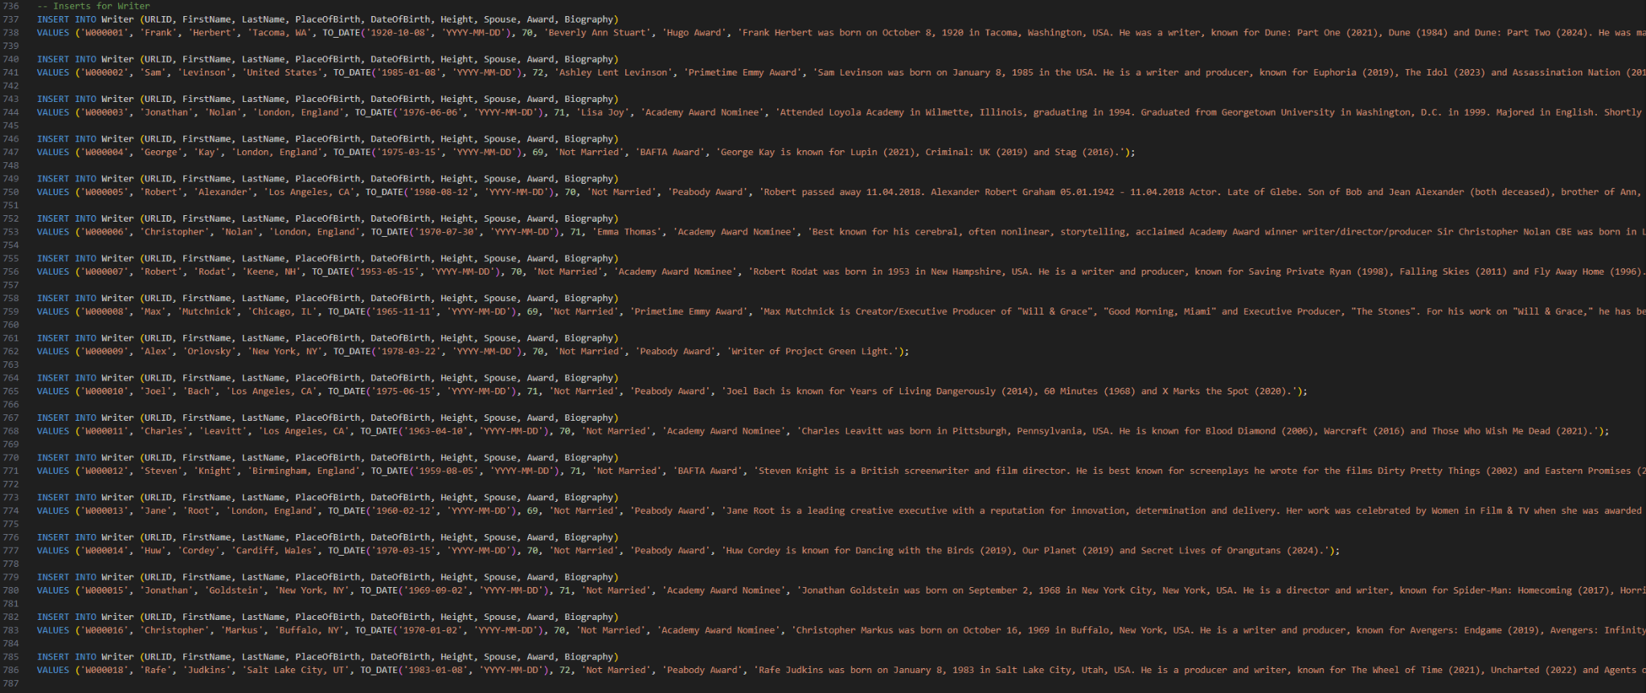

Slide 13
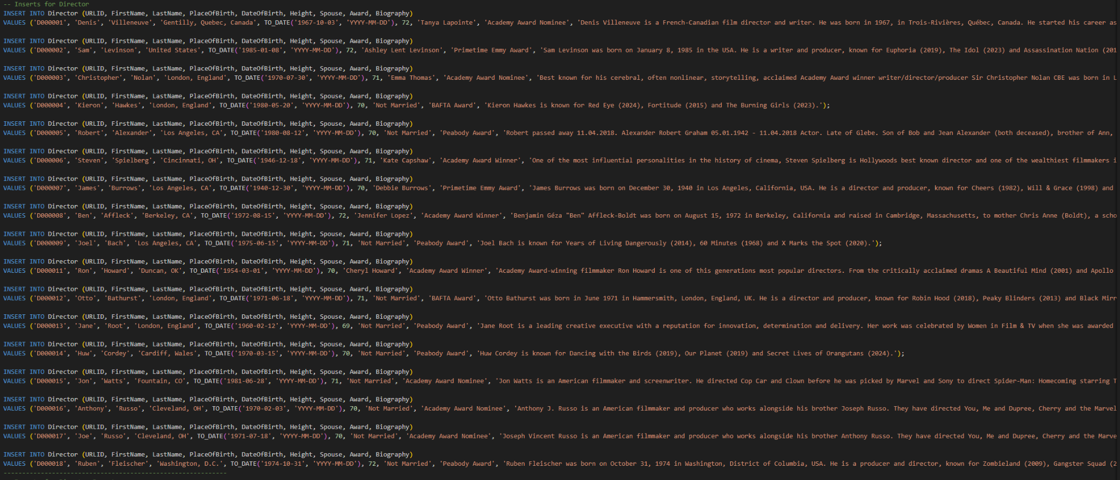

Slide 14
Interesting Query #1
This query joins the tables Movie and Movie Genre.
Retrieves the movie’s title(s) along with its genre(s).
Orders the list alphabetically by genre and groups by genre.

Slide 15

Interesting Query #1
SELECT Movie.Title, Movie_Genre.Genre
FROM Movie, Movie_Genre
WHERE Movie.URLID = Movie_Genre.MovieID
ORDER BY Movie_Genre.Genre;

Slide 16
Interesting Query #2
This query joins the tables Movie Genre and Movie Review.
Retrieves the genre and their calculated average ratings.
The list is ordered from most popular to least popular (highest to lowest).

Slide 17
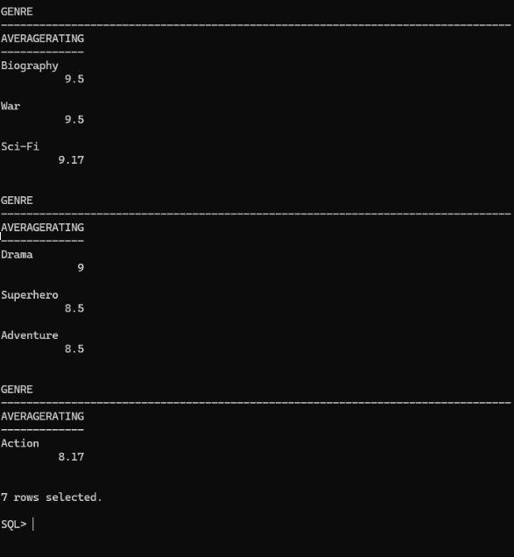
Interesting Query #2
SELECT Genre,
ROUND(AVG(Rating), 2) AS AverageRating
FROM Movie_Genre, Movie_Review
WHERE Movie_Genre.MovieID = Movie_Review.MovieID
GROUP BY Genre
ORDER BY AverageRating DESC;

Slide 18
Interesting Query #3
This query joins the tables Actor, Actor Movie, and Actor TV Show.
Retrieves actors names that have been in both movies and TV shows, and the count of how many movie and TV shows that they have been in.
Groups by the actor’s first and last name and is ordered alphabetically.

Slide 19

Interesting Query #3
SELECT FirstName, LastName, count(DISTINCT Actor_Movie.MovieID) MovieCount,
count(DISTINCT Actor_TV_Show.TV_ShowID) AS TVShowCount
FROM Actor, Actor_Movie, Actor_TV_Show
WHERE Actor.URLID=Actor_Movie.ActorID
AND URLID = Actor_TV_Show.ActorID
AND URLID IN (
SELECT ActorID FROM Actor_Movie
INTERSECT
SELECT ActorID FROM Actor_TV_Show
)
GROUP BY FirstName, LastName
ORDER BY FirstName, LastName;

Slide 20
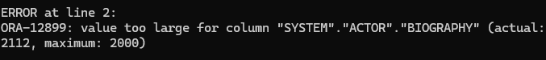
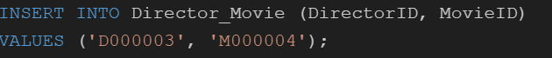
Problems
Inserts for descriptions and biographies are too large for the data type:
Comments removing insert statements:

Slide 21


IMDb Final Project
Subtitle
Date

